Slide 2
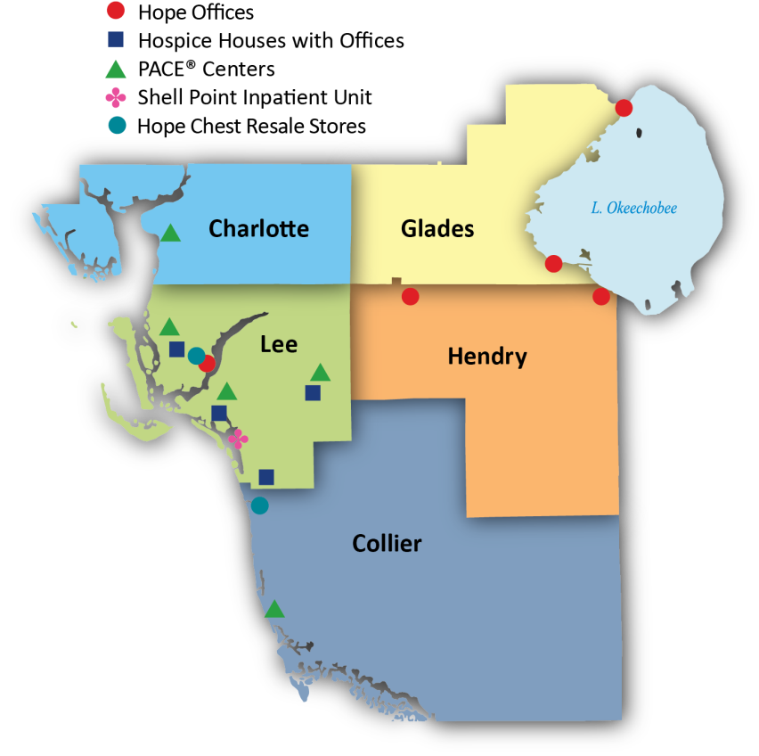
Where We Care
Serving Southwest Florida
for Nearly 40 Years

